Slide 1

Chapter 14 – Sorting and Searching

Slide 2

Chapter Goals
To study several sorting and searching algorithms

Slide 3
To appreciate that algorithms for the same task can differ widely in performance
To understand the big-Oh notation
To estimate and compare the performance of algorithms
To write code to measure the running time of a program

Slide 4
Selection Sort
A sorting algorithm rearranges the elements of a collection so that they are stored in sorted order. Selection sort sorts an array by repeatedly finding
the smallest element of the unsorted tail region and moving it to the front.
Slow when run on large data sets. Example: sorting an array of integers
11 9 17 5 12

Slide 5
Sorting an Array of Integers
Find the smallest and swap it with the first element
5 9 17 11 12
Find the next smallest. It is already in the correct place
5 9 17 11 12
Find the next smallest and swap it with first element of unsorted portion
5 9 11 17 12
4. Repeat
5
9 11 12 17

Slide 6
5. When the unsorted portion is of length 1, we are done
5 9 11 12 17

Slide 7

Selection Sort
In selection sort, pick the smallest element and swap it with the first one. Pick the smallest element of the remaining ones and swap it with the next one, and so on.

Slide 8
section_1/SelectionSorter.java
1 /**
The sort method of this class sorts an array, using the selection
sort algorithm.
4 */
5 public class SelectionSorter
6 {
7 /**
Sorts an array, using selection sort.
@param a the array to sort

Slide 9
section_1/SelectionSortDemo.java
1 import java.util.Arrays;
2
3 /**
This program demonstrates the selection sort algorithm by
sorting an array that is filled with random numbers.
6 */
7 public class SelectionSortDemo
8 {
9 public static void main(String[] args)

Slide 10
section_1/ArrayUtil.java
1 import java.util.Random;
2
3 /**
4 This class contains utility methods for array manipulation.
5 */
6 public class ArrayUtil
7 {
8 private static Random generator = new Random();
9
Typical Program Run:
[65, 46, 14, 52, 38, 2, 96, 39, 14, 33, 13, 4, 24, 99, 89, 77, 73, 87, 36, 81]
[2, 4, 13, 14, 14, 24, 33, 36, 38, 39, 46, 52, 65, 73, 77, 81, 87, 89, 96, 99]

Slide 11
Self Check 14.1
Why do we need the temp variable in the swap method? What would happen if you simply assigned a[i] to a[j] and a[j] to a[i]?
Answer: Dropping the temp variable would not work. Then a[i] and a[j] would end up being the same value.

Slide 12
Self Check 14.2
What steps does the selection sort algorithm go through to sort the sequence 6 5 4 3 2 1?
Answer:
1 5 4 3 2 6
1 2 4 3 5 6
1 2 3 4 5 6

Slide 13
Self Check 14.3
How can you change the selection sort algorithm so that it sorts the elements in descending order (that is, with the largest element at the beginning of the array)?
Answer: In each step, find the maximum of the remaining elements and swap it with the current element (or see Self Check 4).

Slide 14
Self Check 14.4
Suppose we modified the selection sort algorithm to start at the end of the array, working toward the beginning. In each step, the current position is swapped with the minimum. What is the result of this modification?
Answer: The modified algorithm sorts the array in descending order.

Slide 15
Profiling the Selection Sort Algorithm
We want to measure the time the algorithm takes to execute:
Exclude the time the program takes to load Exclude output time
To measure the running time of a method, get the current time immediately before and after the method call.
We will create a StopWatch class to measure execution time of an algorithm:
It can start, stop and give elapsed time
Use System.currentTimeMillis method
Create a StopWatch object:
Start the stopwatch just before the sort
Stop the stopwatch just after the sort
Read the elapsed time

Slide 16
section_2/StopWatch.java
1 /**
A stopwatch accumulates time when it is running. You can
repeatedly start and stop the stopwatch. You can use a
stopwatch to measure the running time of a program.
5 */
6 public class StopWatch
7 {
private long elapsedTime;
private long startTime;

Slide 17
section_2/SelectionSortTimer.java
1 import java.util.Scanner;
2
3 /**
This program measures how long it takes to sort an
array of a user-specified size with the selection
sort algorithm.
7 */
8 public class SelectionSortTimer
9 {
Program Run:
Enter array size: 50000
Elapsed time: 13321 milliseconds

Slide 18
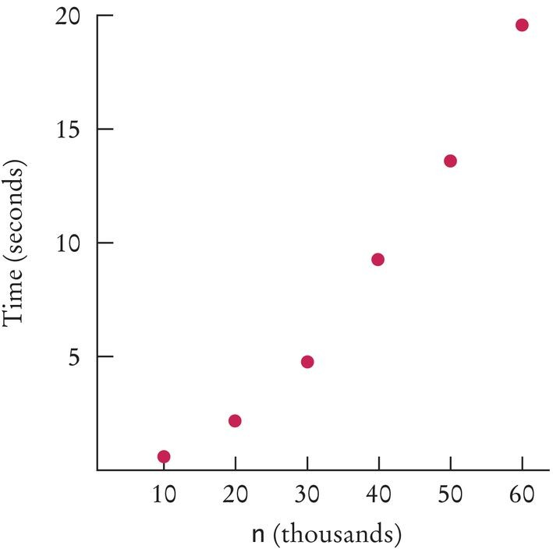
Selection Sort on Various Size Arrays
n | Milliseconds
10,000 | 786
20,000 | 2,148
30,000 | 4,796
40,000 | 9,192
50,000 | 13,321
60,000 | 19,299
Figure 1 Time Taken by Selection Sort
Doubling the size of the array more than doubles the time needed to sort it.

Slide 19
Self Check 14.5
Approximately how many seconds would it take to sort a data set of 80,000 values?
Answer: Four times as long as 40,000 values, or about 37 seconds.

Slide 20
Self Check 14.6
Look at the graph in Figure 1. What mathematical shape does it resemble?
Answer: A parabola.

Slide 21
Analyzing the Performance of the Selection Sort Algorithm
In an array of size n, count how many times an array element is visited:
To find the smallest, visit n elements + 2 visits for the swap To find the next smallest, visit (n - 1) elements + 2 visits for the swap
The last term is 2 elements visited to find the smallest + 2 visits for the swap

Slide 22
Analyzing the Performance of the Selection Sort Algorithm
The number of visits:
n + 2 + (n - 1) + 2 + (n - 2) + 2 + . . .+ 2 + 2
This can be simplified to n² /2 + 5n/2 - 3
5n/2 - 3 is small compared to n² /2 – so let's ignore it
Also ignore the 1/2 – it cancels out when comparing ratios

Slide 23
Analyzing the Performance of the Selection Sort Algorithm
The number of visits is of the order n². Computer scientists use the big-Oh notation to describe the growth rate of a function.
Using big-Oh notation: The number of visits is O(n²). Multiplying the number of elements in an array by 2 multiplies the processing time by 4.
To convert to big-Oh notation: locate fastest-growing term, and ignore constant coefficient.

Slide 24
Self Check 14.7
If you increase the size of a data set tenfold, how much longer does it take to sort it with the selection sort algorithm?
Answer: It takes about 100 times longer.

Slide 25
Self Check 14.8
How large does n need to be so that 1/2 n² is bigger than 5/2 n – 3?
Answer: If n is 4, then n² is 8 and 5/2 n – 3 is 7.

Slide 26
Self Check 14.9
Section 7.3.6 has two algorithms for removing an element from an array of length n. How many array visits does each algorithm require on average?
Answer: The first algorithm requires one visit, to store the new element. The second algorithm requires T(p) = 2 × (n – p – 1) visits, where p is the location at which the element is removed. We don’t know where that element is, but if elements are removed at random locations, on average, half of the removals will be above the middle and half below, so we can assume an average p of n / 2 and T(n) = 2 × (n – n / 2 – 1) = n – 2.

Slide 27
Self Check 14.10
Describe the number of array visits in Self Check 9 using the big-Oh notation.
Answer: The first algorithm is O(1), the second
O(n).

Slide 28
Self Check 14.11
What is the big-Oh running time of checking whether an array is already sorted?
Answer: We need to check that a[0] ≤ a[1], a[1] ≤ a[2], and so on, visiting 2n – 2 elements. Therefore, the running time is O(n).

Slide 29
Self Check 14.12
Consider this algorithm for sorting an array. Set k to the length of the array. Find the maximum of the first k elements. Remove it, using the second algorithm of Section 7.3.6. Decrement k and place the
removed element into the k ^{th} position. Stop if k is 1. What is the algorithm’s running time in big-Oh notation?
Answer: Let n be the length of the array. In the kth step, we need k visits to find the minimum. To remove it, we need an average of k – 2 visits (see Self Check 9). One additional visit is required to add it to the end. Thus, the kth step requires 2k – 1 visits. Because k goes from n to 2, the total number of visits is
2n – 1 + 2(n –1) – 1 + ... + 2 · 3 – 1 + 2 · 2 – 1 =
2(n + (n – 1) + ... + 3 + 2 + 1 – 1) – (n – 1) =
n(n + 1) – 2 – n +1 = n² – 3
(because 1 + 2 + 3 + ... + (n – 1) + n = n (n
+ 1) / 2)
Therefore, the total number of visits is O(n²).

Slide 30
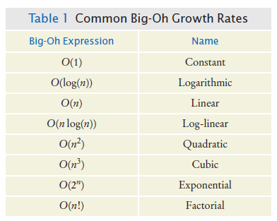
Common Big-Oh Growth Rates

Slide 31
Insertion Sort
Assume initial sequence a[0] . . . a[k] is sorted (k = 0):
11 9 16 5 7
Add a[1]; element needs to be inserted before 11
9 11 16 5 7
Add a[2]
9 11 16 5 7
Add a[3]
5 9 11 16 7
Finally, add a[4] 5 9 11 16 7

Slide 32
Insertion Sort
public class InsertionSorter
{
/**
Sorts an array, using insertion sort.
@param a the array to sort
*/
public static void sort(int[] a)
{
for (int i = 1; i < a.length; i++)
{
int next = a[i];
// Move all larger elements up int j = i;
while (j > 0 && a[j - 1] > next)
{
a[j] = a[j - 1]; j--;
}
// Insert the element a[j] = next;
}
}
}

Slide 33

Insertion Sort
Insertion sort is the method that many people use to sort playing cards. Pick up one card at a time and insert it so that the cards stay sorted.
Insertion sort is an O(n²) algorithm.

Slide 34

Merge Sort
Sorts an array by
Cutting the array in half Recursively sorting each half Merging the sorted halves
Dramatically faster than the selection sort
In merge sort, one sorts each half, then merges the sorted halves.

Slide 35
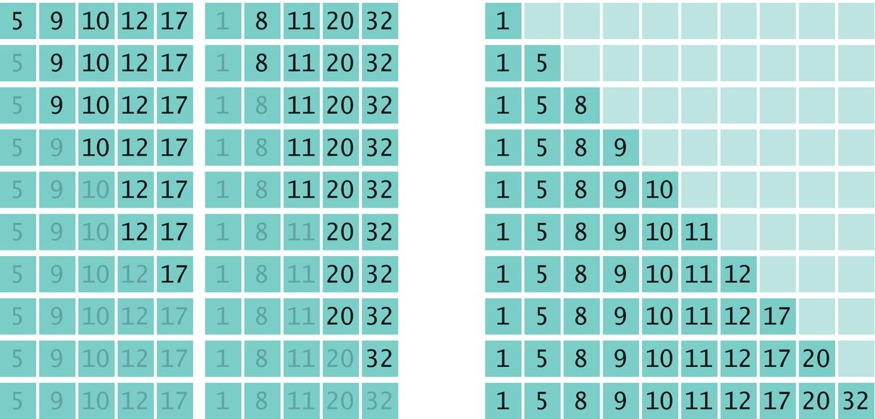
Merge Sort Example
Divide an array in half and sort each half
Merge the two sorted arrays into a single sorted array

Slide 36
Merge Sort
public static void sort(int[] a)
{
if (a.length <= 1) { return; }
int[] first = new int[a.length / 2];
int[] second = new int[a.length - first.length];
// Copy the first half of a into first, the second half into second
. . .
sort(first); sort(second); merge(first, second, a);
}

Slide 37
section_4/MergeSorter.java
1 /**
The sort method of this class sorts an array, using the merge
sort algorithm.
4 */
5 public class MergeSorter
6 {
7 /**
Sorts an array, using merge sort.
@param a the array to sort

Slide 38
section_4/MergeSortDemo.java
1 import java.util.Arrays;
2
3 /**
This program demonstrates the merge sort algorithm by
sorting an array that is filled with random numbers.
6 */
7 public class MergeSortDemo
8 {
9 public static void main(String[] args)
Typical Program Run:
[8, 81, 48, 53, 46, 70, 98, 42, 27, 76, 33, 24, 2, 76, 62, 89, 90, 5, 13, 21]
[2, 5, 8, 13, 21, 24, 27, 33, 42, 46, 48, 53, 62, 70, 76, 76, 81, 89, 90, 98]

Slide 39
Self Check 14.13
Why does only one of the two while loops at the end of the merge
method do any work?
Answer: When the preceding while loop ends, the loop condition must be false, that is, iFirst >= first.length or iSecond >= second.length (De Morgan's Law).

Slide 40
Self Check 14.14
Manually run the merge sort algorithm on the array 8 7 6 5 4 3 2 1.
Answer:
First sort 8 7 6 5.
Recursively, first sort 8 7. Recursively, first sort 8. It's sorted. Sort 7. It's sorted.
Merge them: 7 8.
Do the same with 6 5 to get 5 6.
Merge them to 5 6 7 8.
Do the same with 4 3 2 1: Sort 4 3 by sorting 4 and
3 and merging them to 3 4.
Sort 2 1 by sorting 2 and 1 and merging them to 1 2.
Merge 3 4 and 1 2 to 1 2 3 4.
Finally, merge 5 6 7 8 and 1 2 3 4 to 1 2 3 4 5 6 7 8.

Slide 41
Self Check 14.15
The merge sort algorithm processes an array by recursively processing two halves. Describe a similar recursive algorithm for computing the sum of all elements in an array.
Answer: If the array size is 1, return its only element as the sum. Otherwise, recursively compute the sum of the first and second subarray and return the sum of these two values.

Slide 42
Analyzing the Merge Sort Algorithm
In an array of size n, count how many times an array element is visited.
Assume n is a power of 2: n = 2^{m}.
Calculate the number of visits to create the two sub- arrays and then merge the two sorted arrays:
3 visits to merge each element or 3n visits 2n visits to create the two sub-arrays
total of 5n visits

Slide 43
Analyzing the Merge Sort Algorithm
Let T(n) denote the number of visits to sort an array of n elements then
T(n) = T(n / 2) + T(n / 2) + 5n or T(n) = 2T(n / 2) + 5n
The visits for an array of size n / 2 is: T(n / 2) = 2T(n
/ 4) + 5 n / 2
So T(n) = 2 × 2T( n /4) +5n + 5n
The visits for an array of size n / 4 is: T(n / 4) = 2T(n
/ 8) + 5 n / 4
So T(n) = 2 × 2 × 2T(n / 8) + 5n + 5n + 5n

Slide 44
Analyzing Merge Sort Algorithm
Repeating the process k times: T(n) = 2 ^{k}T( n / 2^{k})
+5nk
Since n = 2^{m}, when k = m: T(n) = 2^{m}T(n / 2^{m}) +5nm T(n) = nT(1) +5nm
T(n) = n + 5nlog₂(n)

Slide 45
Analyzing Merge Sort Algorithm
To establish growth order:
Drop the lower-order term n
Drop the constant factor 5
Drop the base of the logarithm since all logarithms are related by a constant factor
We are left with n log(n)
Using big-Oh notation: number of visits is O(n
log(n)).

Slide 46
Merge Sort Vs Selection Sort
Selection sort is an O(n²) algorithm. Merge sort is an O(n log(n)) algorithm.
The n log(n) function grows much more slowly than
n².

Slide 47
Merge Sort Timing vs. Selection Sort
n
Merge Sort
Selection Sort
 | (milliseconds) | (milliseconds)
10,000 | 40 | 786
20,000 | 73 | 2,148
30,000 | 134 | 4,796
40,000 | 170 | 9,192
50,000 | 192 | 13,321
60,000 | 205 | 19,299
Figure 2 Time Taken by Merge vs.
Selection Sort

Slide 48
Self Check 14.16
Given the timing data for the merge sort algorithm in the table at the beginning of this section, how long would it take to sort an array of 100,000 values?
Answer: Approximately 100,000 × log(100,000) / 50,000 × log(50,000) = 2 × 5 / 4.7 = 2.13 times the
time required for 50,000 values. That's 2.13 × 97 milliseconds or approximately 409 milliseconds.

Slide 49
Self Check 14.17
If you double the size of an array, how much longer will the merge sort algorithm take to sort the new array?
Answer: (2n log(2n) / n log(n)) = 2(1+ log(2) / log(n)). For n > 2, that is a value < 3.

Slide 50

The Quicksort Algorithm
No temporary arrays are required. Divide and conquer
Partition the range
Sort each partition
In quicksort, one partitions the elements into two groups, holding the smaller and larger elements. Then one sorts each group.

Slide 51
The Quicksort Algorithm
public void sort(int from, int to)
{
if (from >= to) return;
int p = partition(from, to); sort(from, p);
sort(p + 1, to);
}

Slide 52



The Quicksort Algorithm
Starting range
A partition of the range so that no element in first section is larger than element in second section
Recursively apply the algorithm until array is sorted

Slide 53
The Quicksort Algorithm
private static int partition(int[] a, int from, int to)
{
int pivot = a[from]; int i = from - 1; int j = to + 1; while (i < j)
{
i++; while (a[i] < pivot) { i++; } j--; while (a[j] > pivot) { j--; }
if (i < j) { ArrayUtil.swap(a, i, j); }
}
return j;
}

Slide 54
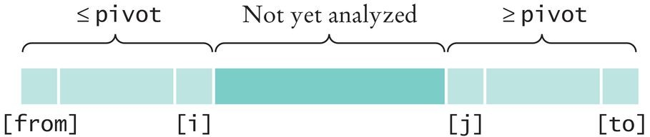
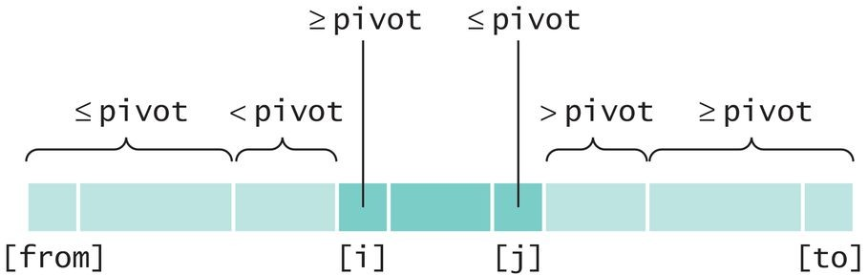
The Quicksort Algorithm - Partitioning
Partitioning a Range
Extending the Partitions

Slide 55
The Quicksort Algorithm
On average, the quicksort algorithm is an O(n
log(n)) algorithm.
Its worst-case run-time behavior is O(n²).
If the pivot element is chosen as the first element of the region,
That worst-case behavior occurs when the input set is already sorted

Slide 56
Searching
Linear search: also called sequential search Examines all values in an array until it finds a match or reaches the end
Number of visits for a linear search of an array of n
elements:
The average search visits n/2 elements The maximum visits is n
A linear search locates a value in an array in O(n) steps

Slide 57
section_6_1/LinearSearcher.java
1 /**
2 A class for executing linear searches in an array.
3 */
4 public class LinearSearcher
5 {
6 /**
Finds a value in an array, using the linear search
algorithm.
@param a the array to search

Slide 58
section_6_1/LinearSearchDemo.java
import java.util.Arrays;
import java.util.Scanner;
3
4
5
6
7
8
9
/**
This program demonstrates the linear search algorithm.
*/
public class LinearSearchDemo
{
public static void main(String[] args)
Program Run:
[46, 99, 45, 57, 64, 95, 81, 69, 11, 97, 6, 85, 61, 88, 29, 65, 83, 88, 45, 88]
Enter number to search for, -1 to quit: 12 Found in position -1
Enter number to search for, -1 to quit: -1

Slide 59
Binary Search
A binary search locates a value in a sorted array by:
Determining whether the value occurs in the first or second half
Then repeating the search in one of the halves
The size of the search is cut in half with each step.

Slide 60




Binary Search
Searching for 15 in this array
The last value in the first half is 9
So look in the second (darker colored) half
The middle element of this sequence is 20, so the value must be in this sequence
Look in the darker colored sequence
The last value of the first half of this very short sequence is 12,
This is smaller than the value that we are searching, so we must look in the second half
15 ≠ 17: we don't have a match

Slide 61
section_6_2/BinarySearcher.java
1 /**
2 A class for executing binary searches in an array.
3 */
4 public class BinarySearcher
5 {
6 /**
Finds a value in a range of a sorted array, using the binary
search algorithm.
@param a the array in which to search

Slide 62
Binary Search
Count the number of visits to search a sorted array of size n
We visit one element (the middle element) then search either the left or right subarray
Thus: T(n) = T(n/2) + 1
If n is n / 2, then T(n / 2) = T(n / 4) + 1
Substituting into the original equation: T(n) = T(n / 4)
+ 2
This generalizes to: T(n) = T(n / 2^{k}) + k

Slide 63
Binary Search
Assume n is a power of 2, n = 2^{m} where m = log₂(n)
Then: T(n) = 1 + log₂(n)
A binary search locates a value in a sorted array in
O(log(n)) steps.

Slide 64
Binary Search
Should we sort an array before searching?
Linear search - O(n) Binary search - O(n log(n))
If you search the array only once
Linear search is more efficient
If you will make many searches
Worthwhile to sort and use binary search

Slide 65
Self Check 14.18
Suppose you need to look through 1,000,000 records to find a telephone number. How many records do you expect to search before finding the number?
Answer: On average, you’d make 500,000 comparisons

Slide 66
Self Check 14.19
Why can’t you use a “for each” loop for (int element : a) in the search method?
Answer: The search method returns the index at which the match occurs, not the data stored at that location.

Slide 67
Self Check 14.20
Suppose you need to look through a sorted array with 1,000,000 elements to find a value. Using the binary search algorithm, how many records do you expect to search before finding the value?
Answer: You would search about 20. (The binary log of 1,024 is 10.)

Slide 68
Problem Solving: Estimating the Running Time of an Algorithm - Linear time
Example: an algorithm that counts how many elements have a particular value
int count = 0;
for (int i = 0; i < a.length; i++)
{
if (a[i] == value) { count++; }
}
Pattern of array element visits

Slide 69
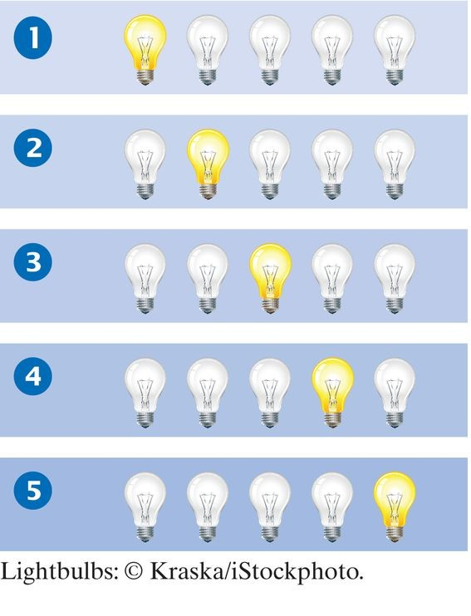
There are a fixed number of actions in each visit independent of n.
A loop with n iterations has O(n) running time if each step consists of a fixed number of actions.

Slide 70
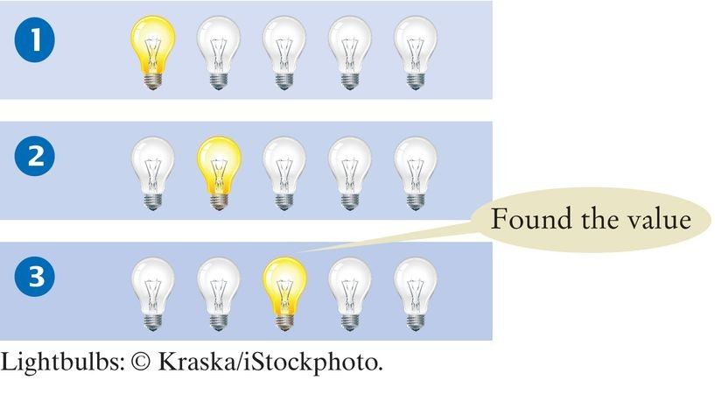
Problem Solving: Estimating the Running Time of an Algorithm - Linear time
Example: an algorithm to determine if a value occurs in the array
boolean found = false;
for (int i = 0; !found && i < a.length; i++)
{
if (a[i] == value) { found = true; }
}
Search may stop in the middle
Still O(n) because we may have to traverse the whole array.

Slide 71

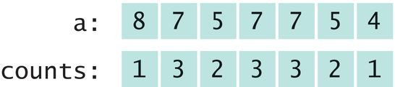
Problem Solving: Estimating the Running Time of an Algorithm - Quadratic time
Problem: Find the most frequent element in an array.
Try it with this array
Count how often each element occurs.
Put the counts in an array
Find the maximum count
It is 3 and the corresponding value in original array is 7

Slide 72
Problem Solving: Estimating the Running Time of an Algorithm - Quadratic time
Estimate how long it takes to compute the counts
for (int i = 0; i < a.length; i++)
{
counts[i] = Count how often a[i] occurs in a
}
We visit each array element once -
O(n)
Count the number of times that element occurs - O(n)
Total running time - O(n²)

Slide 73
Three phases in the algorithm
Compute all counts. - O(n²) Compute the maximum. O(n)
Find the maximum in the counts. O(n)
A loop with n iterations has O(n²) running time if each step takes O(n) time.
The big-Oh running time for doing several steps in a row is the largest of the big-Oh times for each step.

Slide 74
The Triangle Pattern
Try to speed up the algorithm for finding the most frequent element.
Idea - Before counting an element, check that it didn't already occur in the array
At each step, the work is O(i)
In the third iteration, visit a[0] and a[1] again

Slide 75
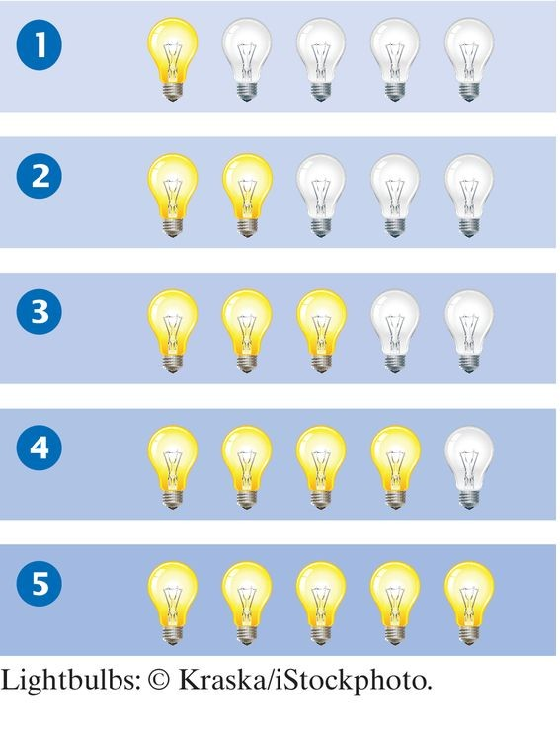
n²/2 lightbulbs are visited (light up) That is still O(n²)
A loop with n iterations has O(n²) running time if the i^{th} step takes O( i ) time.

Slide 76
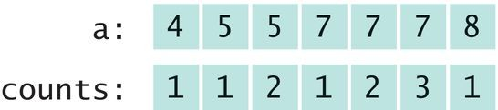
Problem Solving: Estimating the Running Time of an Algorithm - Logarithmic time
Logarithmic time estimates arise from algorithms that cut work in half in each step.
Another ideas for finding the most frequent element in an array:
Sort the array first
This is O(n log(n)) time
Traverse the array and count how many times you have seen that element:

Slide 77
The code
int count = 0;
for (int i = 0; i < a.length; i++)
{
count++;
if (i == a.length - 1 || a[i] != a[i + 1])
{
counts[i] = count; count = 0;
}
}

Slide 78
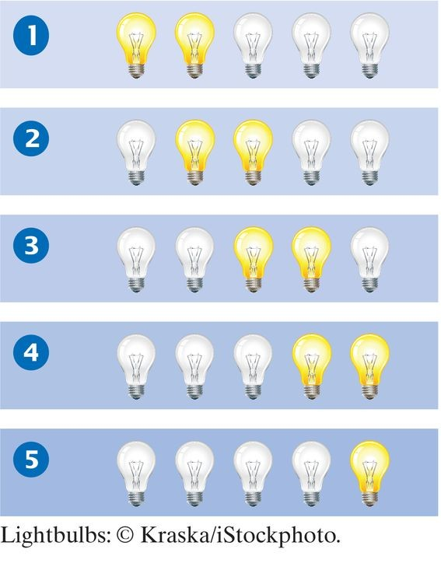
Problem Solving: Estimating the Running Time of an Algorithm - Logarithmic time
This takes the same amount of work per iteration:
visits two elements 2n which is O(n)
Running time of entire algorithm is O(n log(n)).
An algorithm that cuts the size of work in half in each step runs in O(log(n)) time.

Slide 79
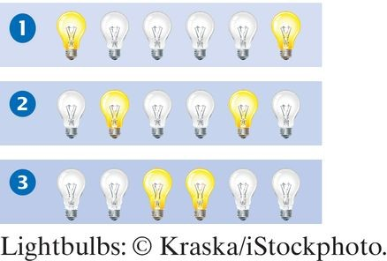
Self Check 14.21
What is the “light bulb pattern” of visits in the following algorithm to check whether an array is a palindrome?
for (int i = 0; i < a.length / 2; i++)
{
if (a[i] != a[a.length - 1 - i]) { return false; }
}
return true;
Answer:

Slide 80
Self Check 14.22
What is the big-Oh running time of the following algorithm to check whether the first element is duplicated in an array?
for (int i = 1; i < a.length; i++)
{
if (a[0] == a[i]) { return true; }
}
return false;
Answer: It is an O(n) algorithm.

Slide 81
Self Check 14.23
What is the big-Oh running time of the following algorithm to check whether an array has a duplicate value?
for (int i = 0; i < a.length; i++)
{
for (j = i + 1; j < a.length; j++)
{
if (a[i] == a[j]) { return true; }
}
}
return false;
Answer: It is an O(n²) algorithm—the number of visits follows a triangle pattern.

Slide 82
Self Check 14.24
Describe an O(n log(n)) algorithm for checking whether an array has duplicates.
Answer: Sort the array, then make a linear scan to check for adjacent duplicates

Slide 83
Self Check 14.25
What is the big-Oh running time of the following algorithm to find an element in an n × n array?
for (int i = 0; i < n; i++)
{
for (j = 0; j < n; j++)
{
if (a[i][j] == value) { return true; }
}
}
return false;
Answer: It is an O(n²) algorithm—the outer and inner loops each have n iterations.

Slide 84
Self Check 14.26
If you apply the algorithm of Section 14.7.4 to an n × n array, what is the big-Oh efficiency of finding the most frequent element in terms of n?
Answer: Because an n × n array has m = n² elements, and the algorithm in Section 14.7.4, when applied to an array with m elements, is O(m log(m)), we have an O(n²log(n)) algorithm. Recall that log(n²)
= 2 log(n), and the factor of 2 is irrelevant in the big- Oh notation.

Slide 85
Sorting and Searching in the Java Library - Sorting
You do not need to write sorting and searching algorithms.
Use methods in the Arrays and Collections classes.
The Arrays class contains static sort methods. To sort an array of integers:
int[] a = . . . ; Arrays.sort(a);
That sort method uses the Quicksort algorithm (see Special Topic 14.3).
To sort an ArrayList, use Collections.sort
ArrayList<String> names = . . .; Collections.sort(names);
Uses merge sort algorithm

Slide 86
Sorting and Searching in the Java Library - Binary Search
Arrays and Collections classes contain static
binarySearch methods.
If the element is not found, returns -k - 1
Where k is the position before which the element should be inserted
For example
int[] a = { 1, 4, 9 };
int v = 7;
int pos = Arrays.binarySearch(a, v);
// Returns –3; v should be inserted before position 2

Slide 87
Comparing Objects
Arrays.sort sorts objects of classes that implement Comparable interface:
The call a.compareTo(b) returns
A negative number if a should come before b
0 if a and b are the same
A positive number otherwise
public interface Comparable<T>
{
int compareTo(T other);
}

Slide 88
Comparing Objects
Several classes in Java (e.g. String and Date) implement Comparable.
You can implement Comparable interface for your own classes.
The Country class could implement Comparable:
public class Country implements Comparable<Country>
{
public int compareTo(Country other)
{
return Double.compare(area, other.area);
}
}
You could pass an array of countries to
Arrays.sort
Country[] countries = new Country[n];
// Add countries
Arrays.sort(countries); // Sorts by increasing area

Slide 89
The Comparator Interface
Arrays.sort(array) sorts the given array...
...provided the elements implement the
Comparable interface
What if you have a class that doesn't?
Or if you want to sort by another criterion?
Then supply an object of a class that implements the Comparator interface
public interface Comparator<T>
{
int compare(T a, T b);
}
compare method returns
a negative integer if a comes before b
a positive integer if a comes after b
zero if a and b are equal, or if their order doesn't matter

Slide 90
Comparator with Lambda Expressions
Before Java 8, using Comparator was cumbersome.
Come up with a class that implements
Comparable
Implement compare method
Construct an object
It's a functional interface ⇒ Can use lambda
expression
Sort strings by increasing length:
Arrays.sort(words, (a, b) -> a.length() - b.length());

Slide 91
Self Check 14.27
Why can't the Arrays.sort method sort an array of Rectangle
objects?
Answer: The Rectangle class does not implement the Comparable interface.

Slide 92
Self Check 14.28
What steps would you need to take to sort an array of BankAccount
objects by increasing balance?
Answer: The BankAccount class needs to implement the Comparable interface. Its compareTo method must compare the bank balances.

Slide 93
Self Check 14.29
Why is it useful that the Arrays.binarySearch method indicates the position where a missing element should be inserted?
Answer: Then you know where to insert it so that the array stays sorted, and you can keep using binary search.

Slide 94
Self Check 14.30
Why does Arrays.binarySearch return –k – 1 and not –k to indicate that a value is not present and should be inserted before position k?
Answer: Otherwise, you would not know whether a value is present when the method returns 0.

